Slide 1
Github Tutorial
How to use Github. >:D

Slide 2
What is Github and Revision Control?
Github is a software that manages revision control, also known as version control or source control.
Revision control manages changes to documents or programs. It can track all versions of the program after you check in and check out.* Therefore, if you have a problem in one of the versions of the program, you can always track the history of the program and use the older version.
Revision control is important for teams especially, because multiple members could be working on the same program at different computers.
Notes:
- check in and check out
- you can go back to older versions if the version doesn't work

Slide 3
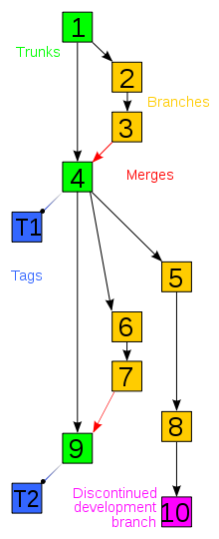
How Does Revision Control Work?
trunk = the versions of the program that actually work
branch = versions that you're working on that don't work yet
merges = when two people check in an edited version of the same program, and the system combines the two programs
tags = a text label associating with a version of a program defining the new changes or any other meaningful information
Notes:
- explain the diagram
- explain about the merges

Slide 4
Why People Need Revision Control?
- A revision control system keeps all the historical versions the easy tracking.
Since we modify the code from time to time and even edit old versions of the code, this will cause many versions of the same file. Revision control keeps track of all the files, so we can get any version at any time.
- A revision control system benefits our team collaboration.
With all the programs in a central repository every team member can access each other's latest revision. If two developers are working on the same file simultaneously, a revision control system helps merge their changes into a new version.
- A revision control system improves efficiency.
In some revision control softwares, you can add descriptions of what you have changed, helping others easily see what each
Notes:
- explain repository (where the files are stored, kind of like a folder)

Slide 5
Steps to Using Github
1. Create a free account on www.github.com
2. Install Git Bash
3. Create a key in Git Bash
4. Copy (clone) the Paradox project files from the Github server to your computer
5. From then on, you just check in your files to the server or retrieve latest files from the server.
Note: Steps 1-4 are unnecessary UNLESS you change your computer. You need to make a new public key for each different account/computer that you use.
Notes:
key = allows you to communicate github server securely

Slide 6
1. Set up Github Account

Slide 7
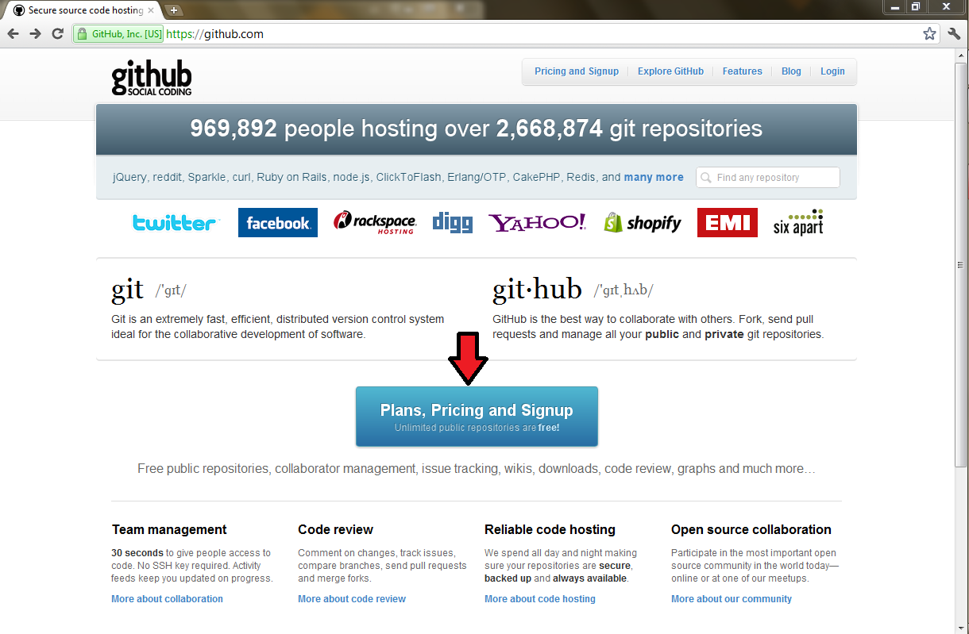

Slide 8
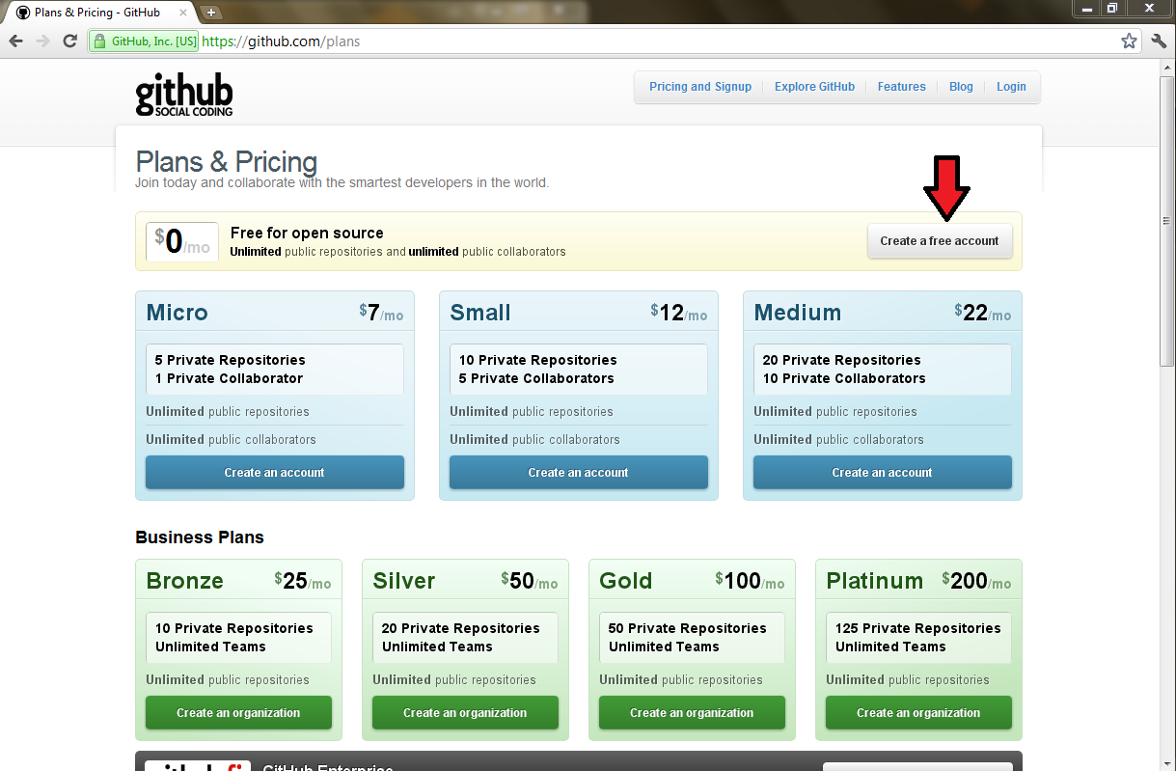

Slide 9
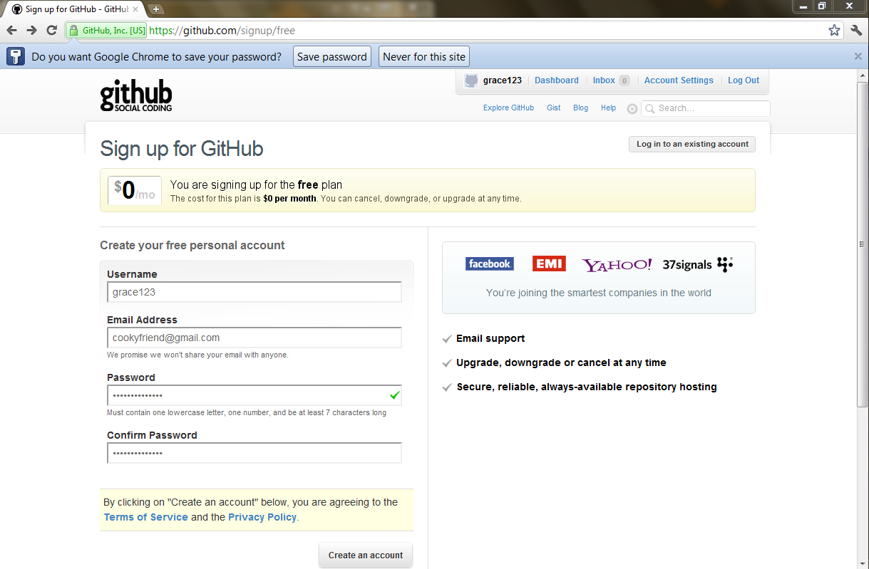

Slide 10
2. Install Git
Follow all the steps once you download git.

Slide 11
3. Create a RSA Key in Git Bash
  Launch Git Bash
  $ cd
  $ ssh-keygen -t rsa -C "your email address"
  $ notepad .ssh/id_rsa.pub
  On the GitHub site Click “Account Settings” > Click “SSH Public Keys” > Click “Add another public key”
  Copy and paste the notepad's contents into the key. Then click "Add key"
  To test the key:
$ ssh -T git@github.com

Slide 12
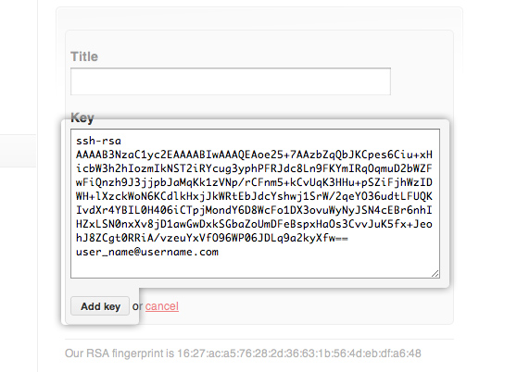

Slide 13
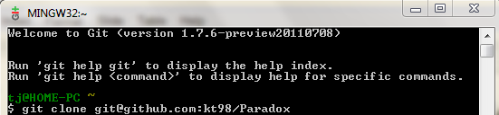
4. Clone Paradox File
Launch Git Bash
$ git clone git@github.com:kt98/Paradox

Slide 14
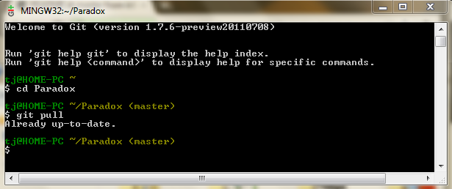
Retrieving the Latest Files
Launch Git Bash
$ cd Paradox
$ git pull

Slide 15
Check In Changes
To add or change files, you can do that without git; simply go to your folders, and under your user, the folder "Paradox" should be there. Drag any files to the folders in Paradox.
After you launch Git Bash
To add single file:
1. $ git add <the file name>
2. $ git commit -m "any comments on your check in"
3. $ git push
To add multiple files:
1. $ git add --all
2. $ git commit -m "any comments on your check in"
3. $ git push

Slide 16
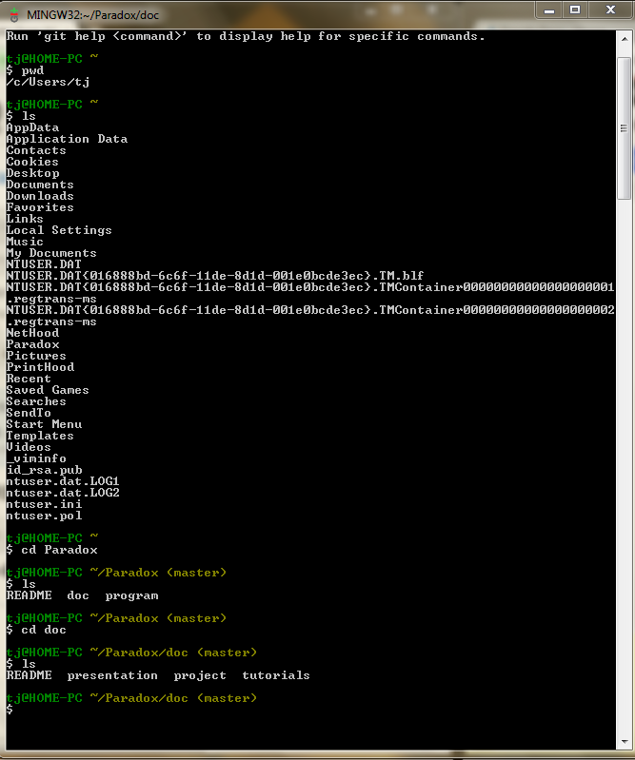
Unix Basics
pwd = show current directory; "where am I?"
ls = list contents in current directory
cd <directory name> = go into a directory

